Slide 1
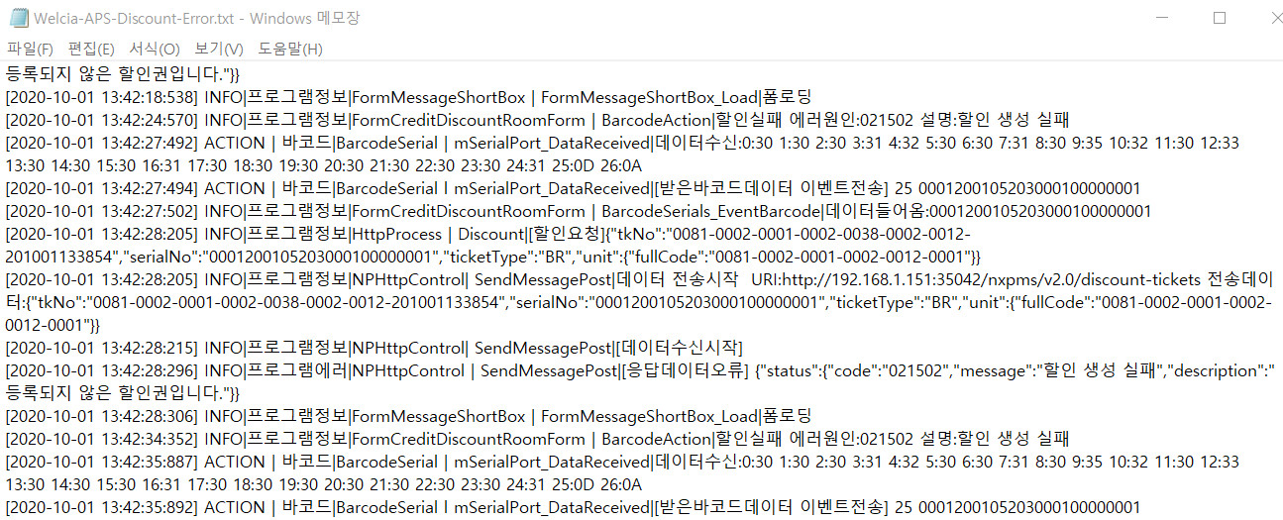
I can't use the discount tickets in my test environment AEON and Welcia.
I used a proven discount ticket that was actually used at Welcia, but it had been cancelled and cannot be used.
Therefore, I can't check the discount tickets in the report.
Regarding Discount ticket error
-> According to Error Log for APS, i think, APS have given the message that "This Ticket is not registered".
the serial number in trouble discount ticket is '0001200105203000100000001'. (WELCIA)
Meaning is “This Ticket is not registered”

Slide 2
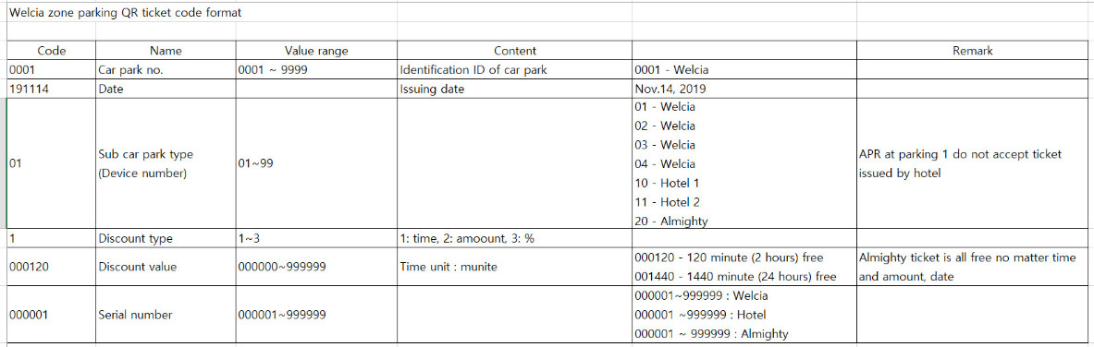
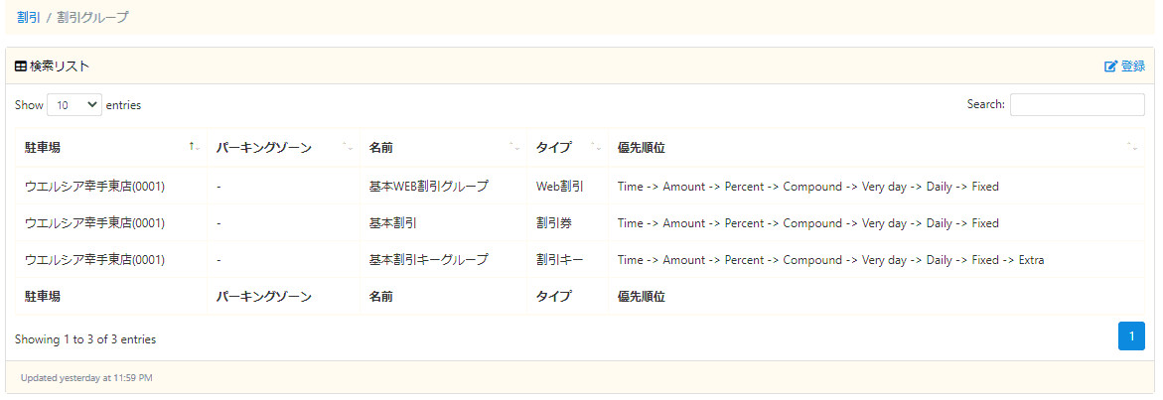
0001200105203000100000001 ( WELCIA )
** Meaning of Serial Code
a) 0001 : parking lot number
b) 200105 : Issue date ( 20 / 01 / 05 )
c) 20: Discount Ticket Dispenser Code ( WELCIA ONLY )
d) 3 : Discount Type ( 1: Time (min), 2: Amount, 3: Percentage )
e) 000100 : Discount Value ( % )
f) 000001 : serial number
If selected by ‘全体’, then PMS is not able to find discount ticket.
so we will revise about this and patch today.

Slide 3
How to set discount ticket. (1) - WELCIA
** Meaning of Serial Code
a) 0001 : parking lot number
b) 200105 : Issue date ( 20 / 01 / 05 )
c) 20: Discount Ticket Dispenser Code ( WELCIA ONLY )
d) 3 : Discount Type ( 1: Time (min), 2: Amount, 3: Percentage )
e) 000100 : Discount Value ( % )
f) 000001 : serial number
NOTE: Never remove or modification Items that already used.

Slide 4
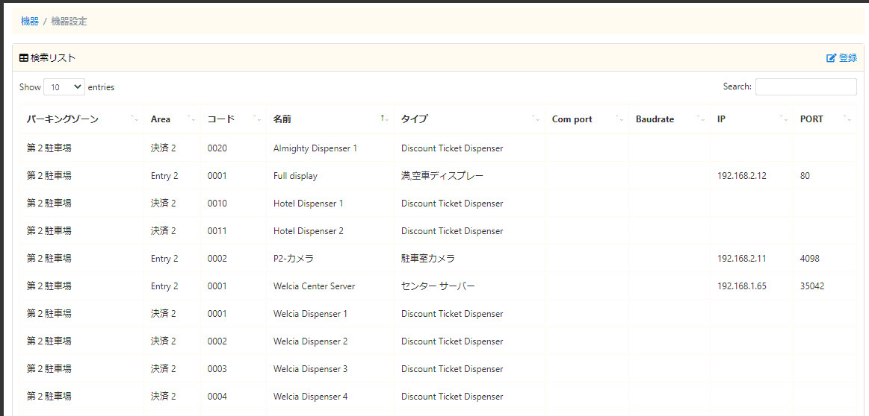
How to set discount ticket. (2) - WELCIA
** Meaning of Serial Code
a) 0001 : parking lot number
b) 200105 : Issue date ( 20 / 01 / 05 )
c) 20: Discount Ticket Dispenser Code ( WELCIA ONLY )
d) 3 : Discount Type ( 1: Time (min), 2: Amount, 3: Percentage )
e) 000100 : Discount Value ( % )
f) 000001 : serial number
NOTE: Never remove or modification Items that already used.

Slide 5
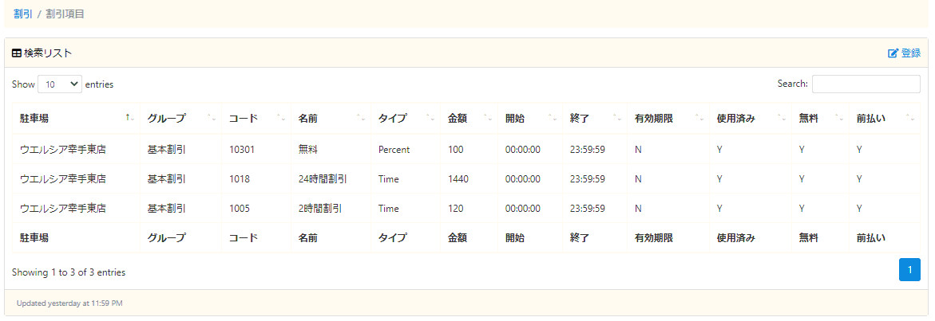
How to set discount ticket. (3) - WELCIA
** Meaning of Serial Code
a) 0001 : parking lot number
b) 200105 : Issue date ( 20 / 01 / 05 )
c) 20: Discount Ticket Dispenser Code ( WELCIA ONLY )
d) 3 : Discount Type ( 1: Time (min), 2: Amount, 3: Percentage )
e) 000100 : Discount Value ( % )
f) 000001 : serial number
NOTE: Never remove or modification Items that already used.

Slide 6
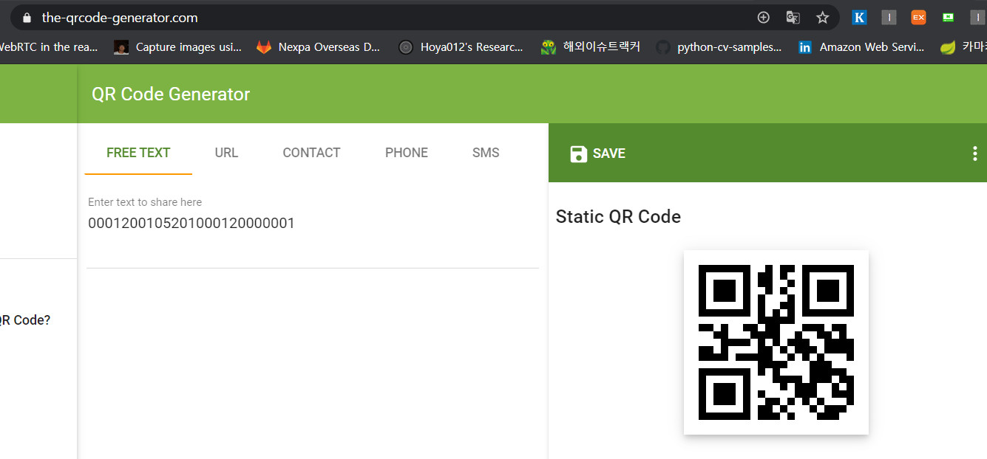
How to make QR code with a Serial Number ( WELCIA )
0001200105203000100000001
4) https://www.the-qrcode-generator.com
0001200105203000100000001

Slide 7
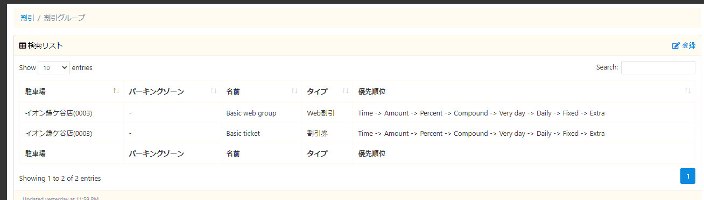
0001052009082000200000004 ( AEON )
** Meaning of Serial Code
a) 000105 : NOT USED
b) 200908 : Issue date ( 20 / 09 / 08 )
c) 2 : Discount Type ( 1: Time (min), 2: Amount, 3: Percentage )
d) 000200 : Discount Value ( meaning is different according to discount type )
e) 000004 : serial number
If selected by ‘全体’, then PMS is not able to find discount ticket.
so we will revise about this and patch today.

Slide 8
-
할인권 반영 조건
Ex: Total parking time : 1 day and 5 hours 45 mins
Ex: the point that reached to Maximum Parking fee while a day
Ex: over the 24 hours
500 Yen
( Maximum fee while a day )
Discount Period
Enable to 100% discount
Ex: the point that a parker do payment by APS
Enable to 24 hours discount ( set option that discount from hehind of parking time zone )
Ex: the point that a parker do payment by APS
Ex: the point that reached to Maximum Parking fee while a day
Enable to 2 hours ( or 30mins ) discount ( set option that discount from hehind of parking time zone )
Ex: the point that a parker do payment by APS
Ex: the point that a parker do payment by APS
Ex: the point that reached to Maximum Parking fee while a day
Discount Ticket is not Reflected
Ex: the point that a parker do payment by APS
Ex: the point that a parker do payment by APS

